Slide 1
DevOps
CI / CD

Slide 2
What is DevOps
DevOps is a culture which promotes collaboration between Development and Operations Team to deploy code to production faster in an automated & repeatable way.
The word 'DevOps' is a combination of two words 'development' and 'operations.’
DevOps is a new term emerging from the collision of two major related trends. The first was also called “agile infrastructure” or “agile operations”; it sprang from applying Agile and Lean approaches to operations work

Slide 3
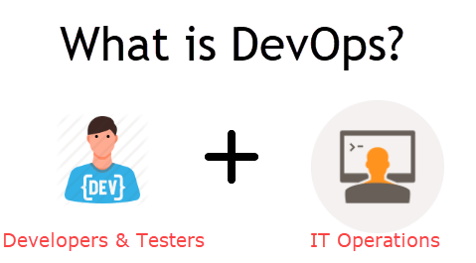
DevOps
An alignment of development and IT operations with better communication and collaboration.

Slide 4
Why Devops?
Before DevOps:-
The development and operation team worked in complete isolation.
Testing and Deployment were isolated activities done after design-build. Hence they consumed more time than actual build cycles.
Team members are spending a large amount of their time in testing, deploying, and designing instead of building the project.
Manual code deployment leads to human errors in production
Coding & operation teams have their separate timelines and are not in sync causing further delays.

Slide 5
Advantages
Increase an Organization’s speed to deliver application and services.
Serve customer’s better
Compete more strongly in the market.

Slide 6
How is DevOps different from traditional IT
Let's compare traditional software waterfall model with DevOps to understand the changes DevOps bring.
We assume the application is scheduled to go live in 2 weeks and coding is 80% done. We assume the application is a fresh launch and the process of buying servers to ship the code has just begun-

Slide 7
Old Process | DevOps
After placing an order for new servers, the Development team works on testing. The Operations team works on extensive paperwork as required in enterprises to deploy the infrastructure. | After placing an order for new servers Development and Operations team work together on the paperwork to set-up the new servers. This results in better visibility of infrastructure requirement.
Projection about failover, redundancy, data center locations, and storage requirements are skewed as no inputs are available from developers who have deep knowledge of the application. | Projection about failover, redundancy, disaster recovery, data center locations, and storage requirements are pretty accurate due to the inputs from the developers.
Operations team has no clue on the progress of the Development team. Operations team develop a monitoring plan as per their understanding. | In DevOps, the Operations team is completely aware of the progress the developers are making. Operations team interact with developers and jointly develop a monitoring plan that caters to the IT and business needs. They also use advance Application Performance Monitoring (APM) Tools
Before go-live, the load testing crashes the application. The release is delayed. | Before go-live, the load testing makes the application a bit slow. The development team quickly fixes the bottlenecks. The application is released on time.

Slide 8
Why DevOps?
Predictability: DevOps offers significantly lower failure rate of new releases
2. Reproducibility: Version everything so that earlier version can be restored anytime.
3. Maintainability: Effortless process of recovery in the event of a new release crashing or disabling the current system.
4. Time to market: DevOps reduces the time to market up to 50% through streamlined software delivery. This is particularly the case for digital and mobile applications.
5. Greater Quality: DevOps helps the team to provide improved quality of application development as it incorporates infrastructure issues.
6. Reduced Risk: DevOps incorporates security aspects in the software delivery lifecycle. It helps in reduction of defects across the lifecycle.
7. Resiliency: The Operational state of the software system is more stable, secure, and changes are auditable.
8. Cost Efficiency: DevOps offers cost efficiency in the software development process which is always an aspiration of IT companies' management.
9. Breaks larger code base into small pieces: DevOps is based on the agile programming method. Therefore, it allows breaking larger code bases into smaller and manageable chunks.

Slide 9
When to Use and When Not to Use?
Use
Large Distributed Applications like Ecommerce
Applications hosted on Cloud Platform
NOT to Use
Mission Critical Applications like Bank, Power and other sensitive data sites.
These applications need:
Strict Access control on the production Environment
Detailed Change management policy
Access control policy to the data centres

Slide 10
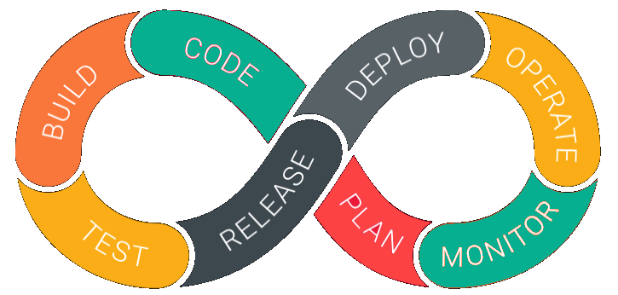
DevOps Lifecycle

Slide 11
DevOps is deep integration between development and operations. Understanding DevOps is not possible without knowing DevOps lifecycle.
Here is a brief information about the Continuous DevOps life-cycle:
1. Development
In this DevOps stage the development of software takes place constantly. In this phase, the entire development process is separated into small development cycles. This benefits DevOps team to speed up software development and delivery process.
2. Testing
QA team use tools like Selenium to identify and fix bugs in the new piece of code.
3. Integration
In this stage, new functionality is integrated with the prevailing code, and testing takes place. Continuous development is only possible due to continuous integration and testing.
4. Deployment
In this phase, the deployment process takes place continuously. It is performed in such a manner that any changes made any time in the code, should not affect the functioning of high traffic website.
5. Monitoring
In this phase, operation team will take care of the inappropriate system behavior or bugs which are found in production.

Slide 12
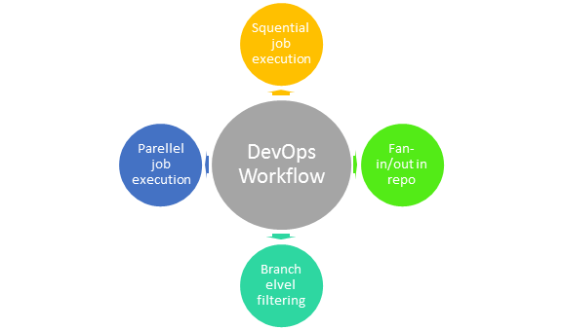
DevOps Work Flow
Workflows provide a visual overview of the sequence in which input is provided. It also tells about actions that are performed, and output is generated for an operations process.
Workflow allows the ability to separate and arrange jobs which are top-requested by the users. It also gives the ability to mirror their ideal process in the configuration jobs.

Slide 13
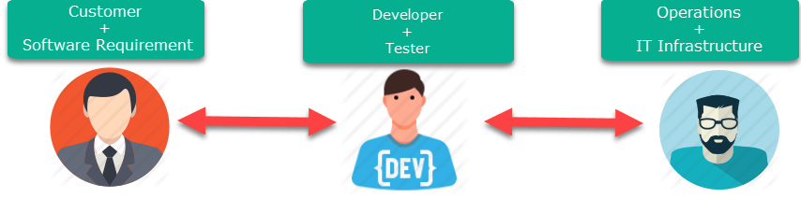
DevOps vs Agile
Stakeholders and communication chain in a typical IT process.
Agile
DevOps

Slide 14
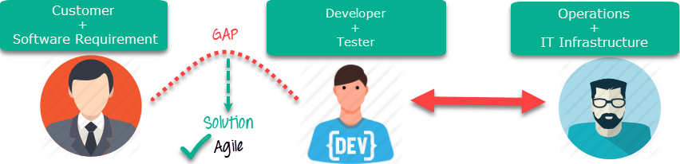
Agile addresses gaps in Customer and Developer communications

Slide 15
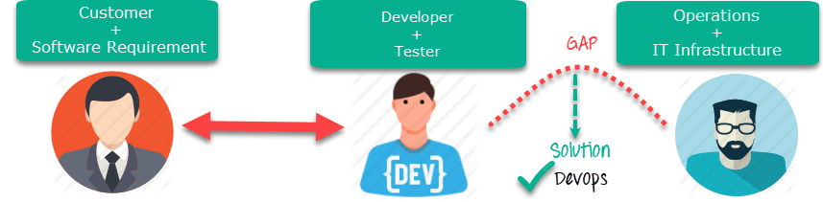
DevOps addresses gaps in Developer and IT Operations communications

Slide 16
Agile | DevOps
Emphasize breaking down barriers between developers and management. | DevOps is about software deployment and operation teams.
Addresses gap between customer requirements and development teams. | Addresses the gap between development and Operation team
Focuses more on functional and non-functional readiness | It focuses operational and business readiness.
Agile development pertains mainly to the way development is thought out by the company. | DevOps emphases on deploying software in the most reliable and safest ways which aren't necessarily always the fastest.
Agile development puts a huge emphasis on training all team members to have varieties of similar and equal skills. So that, when something goes wrong, any team member can get assistance from any member in the absence of the team leader. | DevOps, likes to divide and conquer, spreading the skill set between the development and operation teams. It also maintains consistent communication.
Agile development manages on "sprints. It means that the time table is much shorter (less than a month) and several features are to be produced and released in that period. | DevOps strives for consolidated deadlines and benchmarks with major releases, rather than smaller and more frequent ones.

Slide 17
DevOps Principles
Here, are six principles which are essential when adopting DevOps:
1. Customer-Centric Action: DevOps team must take customer-centric action for that they should constantly invest in products and services.
2. End-To-End Responsibility: The DevOps team need to provide performance support until they become end-of-life. This enhances the level of responsibility and the quality of the products engineered.
3. Continuous Improvement: DevOps culture focuses on continuous improvement to minimize waste. It continuously speeds up the improvement of product or services offered.
4. Automate everything: Automation is a vital principle of DevOps process. This is not only for the software development but also for the entire infrastructure landscape.
5. Work as one team: In the DevOps culture role of the designer, developer, and tester are already defined. All they needed to do is work as one team with complete collaboration.
6. Monitor and test everything: It is very important for DevOps team to have a robust monitoring and testing procedures.

Slide 18
DevOps Automation Tools
Different categories of Automation:
Infrastructure Automation
AWS, Azure
Configuration Management
Chef, Puppet
Deployment Automation
Jenkins
Performance Management
App Dynamic
Log Management
Splunk
Monitoring.
Nagios

Slide 19
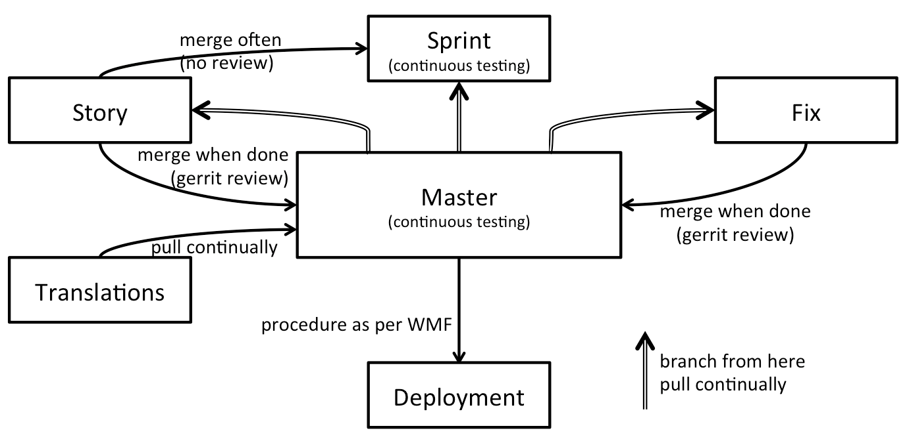
DevtestOps
Everyone has heard of DevOps, and most companies have started to embrace it as an approach. DevOps has a huge impact on software deployment, failure recovery, and feature delivery. But DevOps can only take you so far. Enter DevTestOps, where the worlds of DevOps and Continuous Testing merge.

Slide 20
Contd..
DevOps evolved from agile development’s whole team approach to building quality in.
Testers and QA professionals are part of cross-functional software delivery teams that practice DevOps.”
They make the key point that testing should be part of every discussion and conversation. “…from building, shared understanding as new features are planned, to managing the delivery pipeline, to monitoring and observing production usage, to shortening the mean time to recover from production issues”.

Slide 21
DevSecOps
DevOps isn’t just about development and operations teams. If you want to take full advantage of the agility and responsiveness of a DevOps approach, IT security must also play an integrated role in the full life cycle of your apps.
Why? In the past, the role of security was isolated to a specific team in the final stage of development. That wasn’t as problematic when development cycles lasted months or even years, but those days are over. Effective DevOps ensures rapid and frequent development cycles (sometimes weeks or days), but outdated security practices can undo even the most efficient DevOps initiatives.

Slide 22
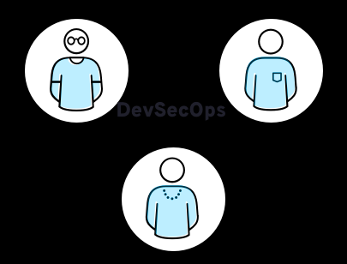
Contd..
Now, in the collaborative framework of DevOps, security is a shared responsibility integrated from end to end. It’s a mindset that is so important, it led some to coin the term “DevSecOps” to emphasize the need to build a security foundation into DevOps initiatives.

Slide 23
Contd..
DevSecOps means thinking about application and infrastructure security from the start. It also means automating some security gates to keep the DevOps workflow from slowing down. Selecting the right tools to continuously integrate security, like agreeing on an integrated development environment (IDE) with security features, can help meet these goals. However, effective DevOps security requires more than new tools—it builds on the cultural changes of DevOps to integrate the work of security teams sooner rather than later.

Slide 24
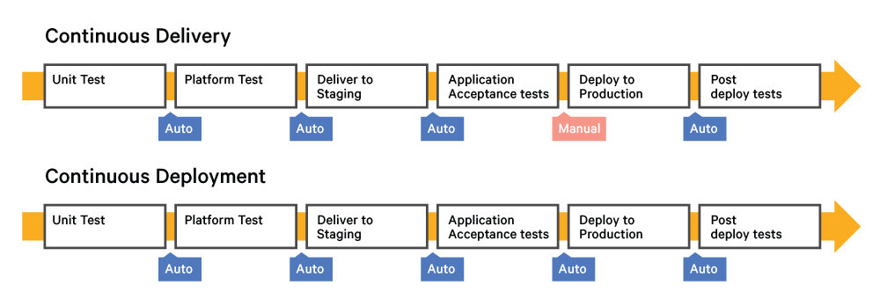
Continuous Delivery vs Continuous Deployment
Continuous Delivery is a state of being ready and able to release any version at any time on any platform, whereas Continuous Deployment is being able to continually deploy. Both require an Agile process that provides a framework where you work on small, frequent changes and obtain feedback.

